Slide 1

MAHARANI LAKSHMI AMMANNI COLLEGE FOR WOMEN AUTONOMOUS DEPARTMENT OF COMPUTER SCIENCE PROJECT TITTLE YOUTUBE MUSIC RECOMMENDATION SYSTEM
GUIDED BY:
MS . Gayatri Bai . S
DEPARTMENT OF COMPUTER SCIENCE PRESENTED BY:
LAYA K N D RAJESWARI K HARSMITHA G P ANKITHA
[U18EE22S0175] [U18EE22S0122] [U18EE22S0170] [U18EE22S0005]

Slide 2
ABSTRACT
The YouTube Music Recommender is a Python-based application that allows users to search for music videos on YouTube by entering a song name or mood.
The key goals include Efficient Search , User Interface , YouTube Integration , Music Discovery.
The app is designed to simplify music discovery by providing a quick and user-friendly way to explore YouTube’s music offerings.

Slide 3
LITERATURE SURVEY
TITTLE | AUTHOR | EXPLANATION
Music Recommendation System | Akash S. Verulkar1 , Adesh N. Mulik2 , Suraj A. Dukare3 , Prof. Swati S. Bharad4 | The paper discusses the design and implementation of a music recommendation system that helps users discover music tailored to their preferences.
A Survey of Music Recommendation Systems and Future Perspectives | Yading Song, Simon Dixon, and Marcus Pearce | examines how music recommendation systems assist users in discovering music that aligns with their preferences. It acknowledges the increasing need for efficient recommendations due to the vast amount of digital music available today.
Music Recommendation System Using Machine Learning | Rajesh Kumar; Rakesh | It discusses the architecture, methodologies, and benefits of using machine learning to personalize music recommendations effectively.

Slide 4
TOOLS/TECHNOLOGIES USED
Hardware components :
System : intel i3 processor.
Hard Disk : 500 GB.
Monitor : 15’’ LED Display.
Input Devices : Keyboard, Mouse.
Ram : 8GB.
SOFTWARE COMPONENTS :
IDLE(Python3.13 64Bit) : IDLE is Python’s Integrated Development and Learning Environment.
Tkinter : A Python library used for building the graphical user interface (GUI) of the application It provides widgets like labels, buttons, and text boxes that allow for easy interaction with users.
Web browser Module : A built-in Python module used to open the YouTube search results in the user’s default web browser, allowing direct access to the recommended music content.

Slide 5
EXISTING SYSTEM
Provide users with a convenient way to discover music based on a song name, mood, or keyword.
The primary objective of this project is to design and develop a user-friendly application that allows users to find music videos on YouTube based on their search queries.
This project achieves the goal of helping users discover music more efficiently, making the experience of finding new songs enjoyable and convenient.

Slide 6
PROPOSED SYSTEM
It generates a search URL for relevant music content and displays it to the user, offering an option to open the results in a web browser results in a web browser .
The app is designed to simplify music discovery by providing a quick and user-friendly way to explore YouTube’s music offerings .
It leverages the Tkinter library for the graphical interface and the web browser module for seamless integration with YouTube .

Slide 7
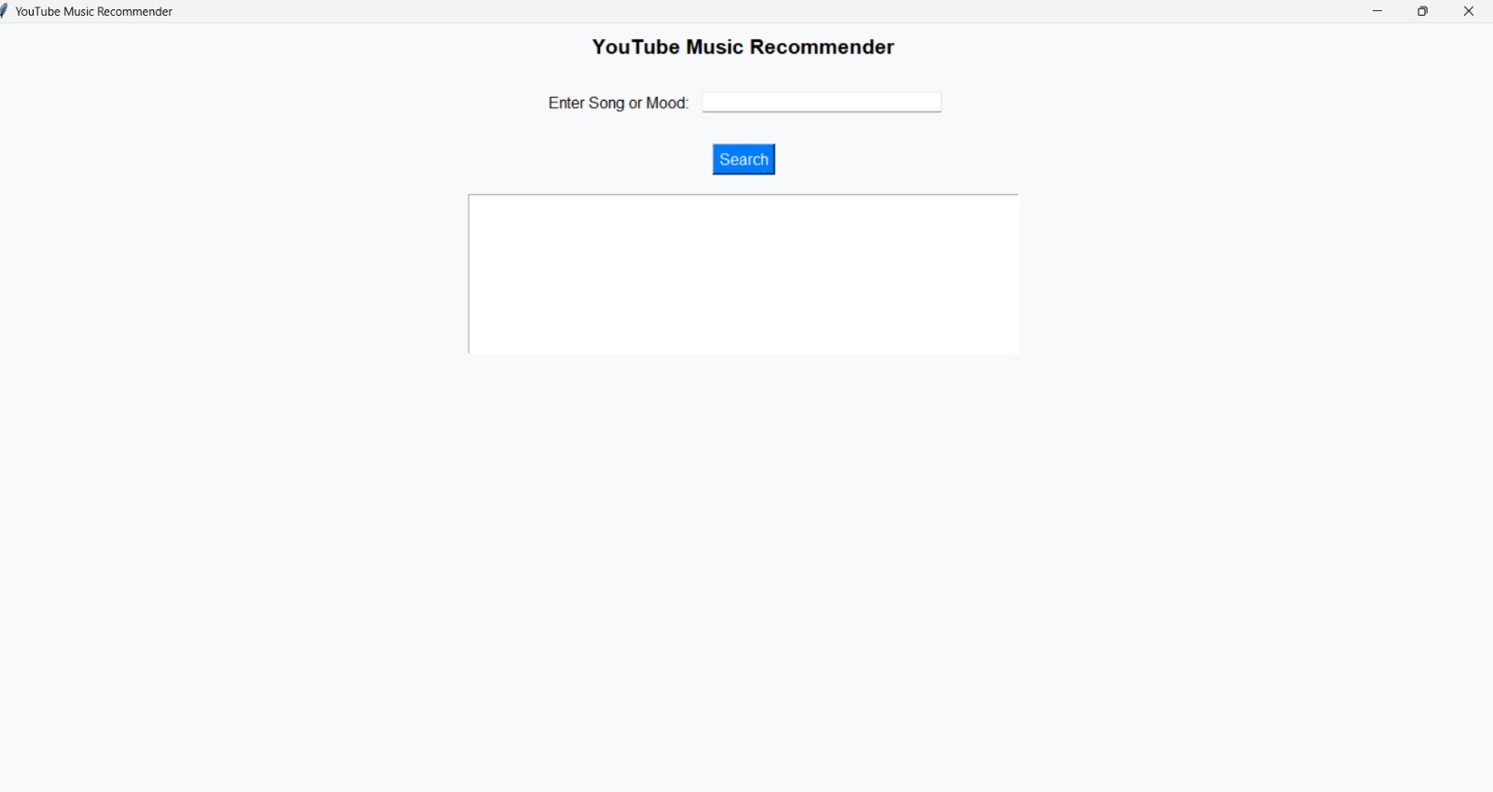
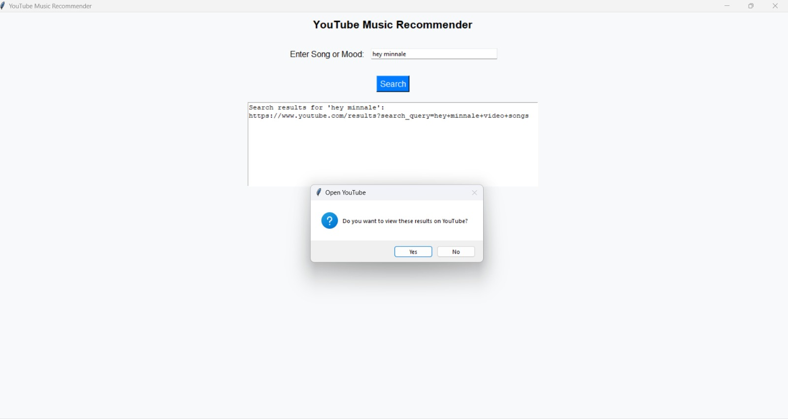
SNAPSHOTS

Slide 8
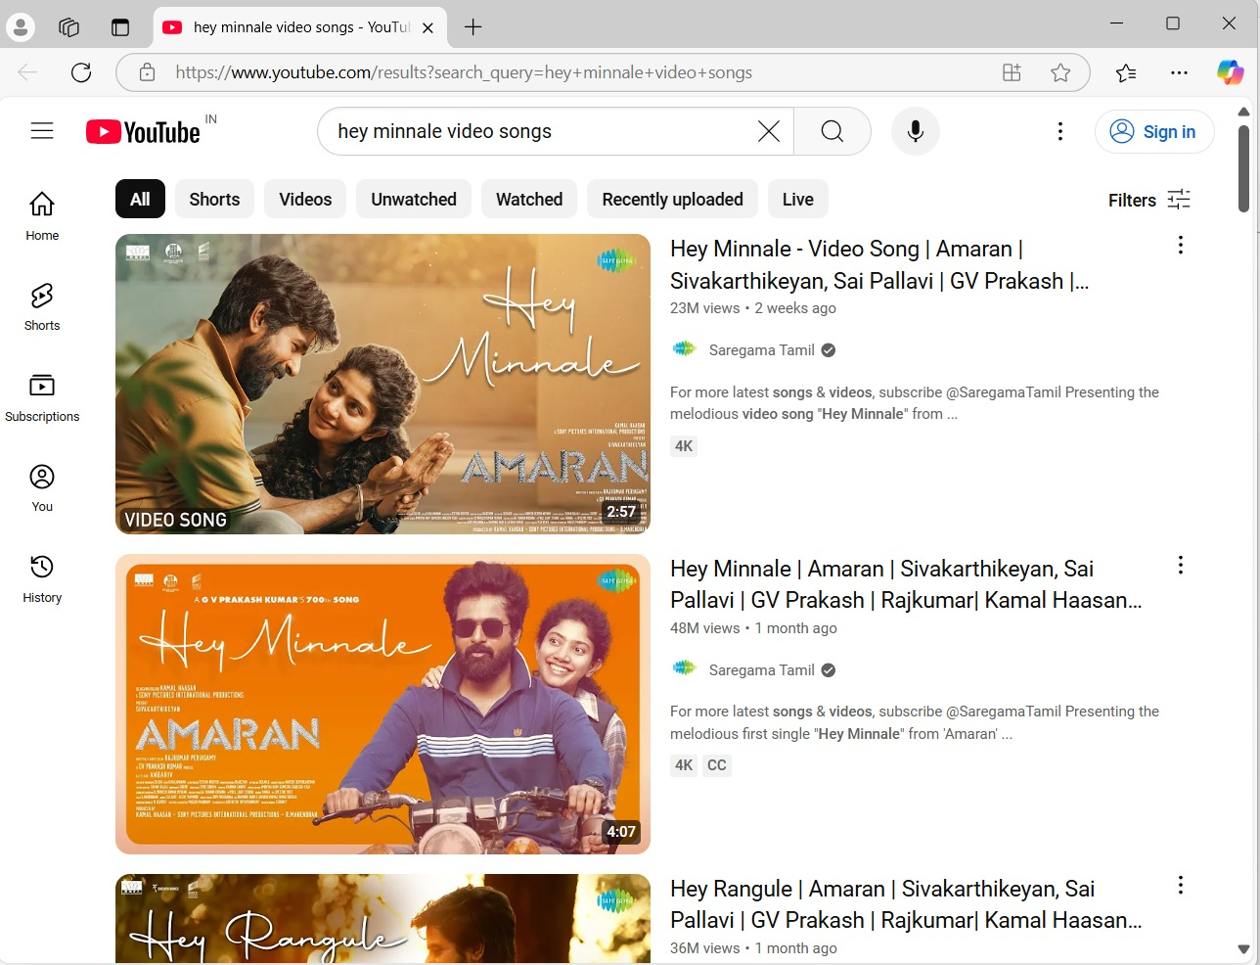

Slide 9
CONCLUSION
The YouTube Music Recommender application provides an effective and user- friendly way for individuals to discover music tailored to their preferences.
By utilizing Python, Tkinter, and web integration through the Web Browser module, the app simplifies the process of exploring YouTube’s music content.
The program allows users to input a song or mood, receive a customized search URL, and then access the results directly in a web browser.
This project achieves the goal of helping users discover music more efficiently, making the experience of finding new songs enjoyable and convenient.

Slide 10
FUTURE SCOPE
The YouTube Music Recommender can be enhanced by integrating the YouTube API to display video details like titles and thumbnails for more informative recommendations.
Additionally, mood-based music suggestions could be implemented using sentiment analysis or machine learning.
Future versions could also include the ability to generate custom playlists based on search criteria, improving the user experience.
Further, expanding the app into a mobile version or adding voice recognition for hands-free operation could increase its accessibility and convenience.
These improvements would make the app more interactive and personalized.

Slide 11
THANK YOU

